Slide 1
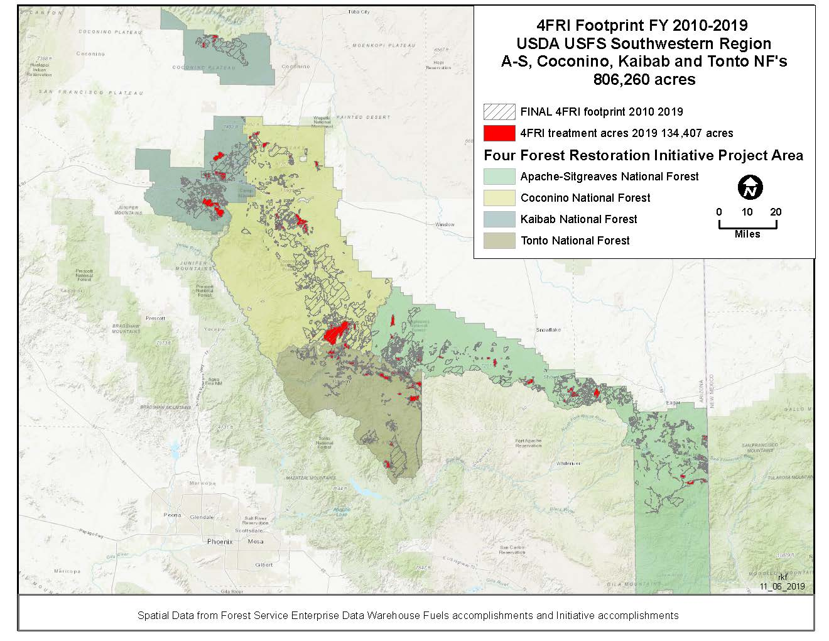
10 Years of 4FRI Implementation Accomplishments
4FRI February Stakeholders Meeting
February 25, 2020

Slide 2
Overall 4FRI Goals
Total area for mechanical restoration treatments: ~1 million acres over ~20 years
Provide for the re-establishment of natural fire patterns across the landscape
Restore and/or maintain watershed conditions that will secure favorable flows of water and maintain water quality
Maintain and/or develop industry to implement restoration work and create jobs

Slide 3
Restoration from CFLRP Act
Restoration is defined in the act¹ as the following activities:
(A) Reduce the risk of uncharacteristic wildfire, including through the use of fire for ecological restoration and maintenance and reestablishing natural fire regimes, where appropriate;
(B) Improve fish and wildlife habitat, including for endangered, threatened, and sensitive species;
(C) Maintain or improve water quality and watershed function;
(D) Prevent, remediate, or control invasions of exotic species;
(E) Maintain, decommission, and rehabilitate roads and trails;
(F) Use woody biomass and small-diameter trees produced from projects implementing the strategy;
¹PL 111-11 Omnibus Public Land Management Act of 2009 Title IV Sec 4003 (c) (3)

Slide 4
4FRI Implementation 2010-2019
Performance Measure | Unit of measure | 2010 | 2011 | 2012 | 2013 | 2014 | 2015 | 2016 | 2017 | 2018 | 2019 | TOTAL | Average per year
Acres of forest vegetation established | Acres | 1,921 | 121 | 11,360 | 3,833 | 2,660 | 15,011 | 11,972 | 8,843 | 7,745 | 9,212 | 72,678 | 7,268
Acres of forest vegetation improved | Acres | 12,764 | 8,864 | 4,712 | 24,519 | 18,409 | 21,402 | 29,483 | 11,189 | 14,434 | 13,948 | 159,724 | 15,972
Manage noxious weeds and invasive plants | Acre | 5,202 | 2,546 | 2,302 | 3,892 | 530 | 598 | 1,488 | 609 | 1,343 | 1,228 | 19,739 | 1,974
Highest priority acres treated for invasive terrestrial and aquatic species on NFS lands | Acres |  | 0 | 0 | 0 | 0 | 0 | 0 | 0 | 0 | 0 | 0 | 0
Acres of water or soil resources protected, maintained or improved to achieve desired watershed conditions. | Acres | 16,763 | 11,767 | 2,968 | 22,653 | 38,145 | 28,186 | 43,822 | 56,439 | 50,121 | 41,983 | 312,847 | 31,285
Acres of lake habitat restored or enhanced | Acres | 2.5 | 0 | 0 | 0 | 0 | 8.8 | 92 | 0 | 0 | 0 | 103 | 10
Miles of stream habitat restored or enhanced | Miles | 14.6 | 0 | 2 | 0 | 33.7 | 3.3 | 31 | 9 | 8 | 23 | 125 | 13
Acres of terrestrial habitat restored or enhanced | Acres | 59,745 | 99,571 | 10,167 | 48,570 | 86,043 | 53,024 | 134,755 | 89,580 | 105,520 | 86,739 | 773,714 | 77,371
Acres of rangeland vegetation improved | Acres | 32,740 | 78 | 1,774 | 8,749 | 12,235 | 30,237 | 30,341 | 11,215 | 39,224 | 22,431 | 189,024 | 18,902
Miles of high clearance system roads receiving maintenance | Miles | 998 | 46 | 137 | 144 | 310 | 335 | 555 | 315 | 266 | 181 | 3,287 | 329
Miles of passenger car system roads receiving maintenance | Miles | 683 | 245 | 595 | 681 | 773 | 886 | 1,195 | 241 | 375 | 165 | 5,839 | 584
Miles of road decommissioned | Miles | 16 | 0 | 35 | 9 | 13.8 | 3 | 0.25 | 1.8 | 14.8 | 12 | 106 | 11
Miles of passenger car system roads improved | Miles | 73 | 23 | 27 | 39 | 70 | 75 | 65 | 59 | 38 | 7 | 476 | 48
Miles of high clearance system road improved | Miles | 84 | 0 | 0 | 17 | 5 | 115 | 27 | 19 | 14 | 20 | 301 | 30
Number of stream crossings constructed or reconstructed to provide for aquatic organism passage | Number |  | 1 | 0 | 0 | 0 | 0 | 0 | 0 | 0 | 0 | 1 | 0
Miles of system trail maintained to standard | Miles | 136.5 | 70.8 | 264 | 138 | 71 | 160 | 76 | 86.4 | 203.104 | 73 | 1,279 | 128
Miles of system trail improved to standard | Miles | 20 | 5.3 | 65 | 19 | 8 | 7.7 | 14 | 15.3 | 9.3 | 5 | 169 | 17
Miles of property line marked/maintained to standard | Miles | 11.65 | 0 | 0 | 0 | 61 | 13 | 13 | 0 | 19.2 | 13.25 | 131 | 13
Acres of forestlands treated using timber sales | Acres | 8,480 | 867 | 5,043 | 7,013 | 10,669 | 13,672 | 10,764 | 10,260 | 7,992 | 8,192 | 82,952 | 8,295
Volume of timber sold (CCF) | CCF | 137,805 | 94,961 | 102,400 | 58,054 | 183,277 | 257,882 | 174,125 | 233,092 | 180,863 | 250,473 | 1,672,932 | 167,293
Green tons from small diameter and low value trees removed from NFS lands and made available for bio-energy production | Green tons | 382,357 | 220,977 | 275,483 | 728,557 | 92,747 | 96,811 | 116,688 | 111,493 | 140,694 | 105,893 | 2,271,700 | 227,170
Acres of hazardous fuels treated outside the wildland/urban interface (WUI) to reduce the risk of catastrophic wildland fire | Acre | 48,546 | 5,587 | 9,032 | 8,082 | 25,178 | 23,709 | 99,090 | 45,951 | 40,342 | 44,871 | 350,388 | 35,039
Acres of wildland/urban interface (WUI) high priority hazardous fuels treated to reduce the risk of catastrophic wildland fire | Acres | 51,126 | 28,816 | 28,798 | 57,229 | 37,214 | 35,894 | 55,336 | 59,802 | 88,826 | 70,271 | 513,312 | 51,331
Number of priority acres treated annually for invasive species on Federal lands | Acres |  | 0 | 0 | 0 | 0 | 0 | 0 | 0 | 0 | 0 | 0 | 0
Number of priority acres treated annually for native pests on Federal lands | Acres |  | 733 | 0 | 0 | 0 | 0 | 0 | 0 | 0 | 0 | 733 | 73

Slide 5
The Good

Slide 6
The Good

Slide 7
The Good

Slide 8
The Good

Slide 9
The Good

Slide 10
The Good

Slide 11
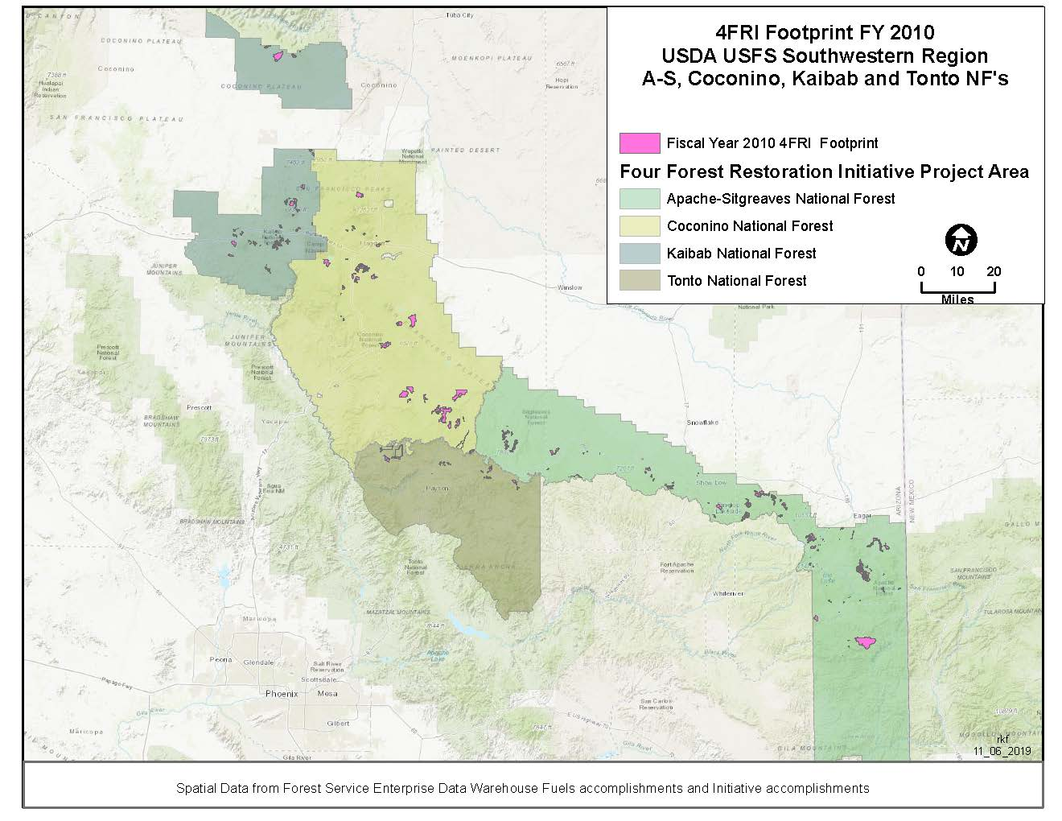

Slide 12
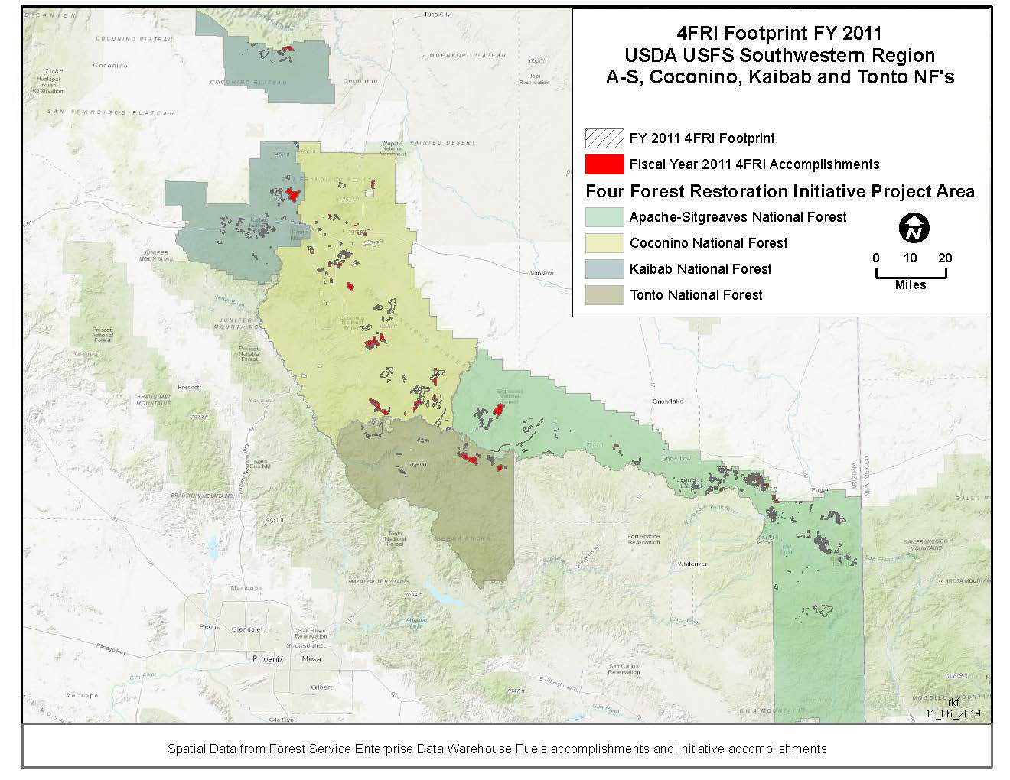

Slide 13
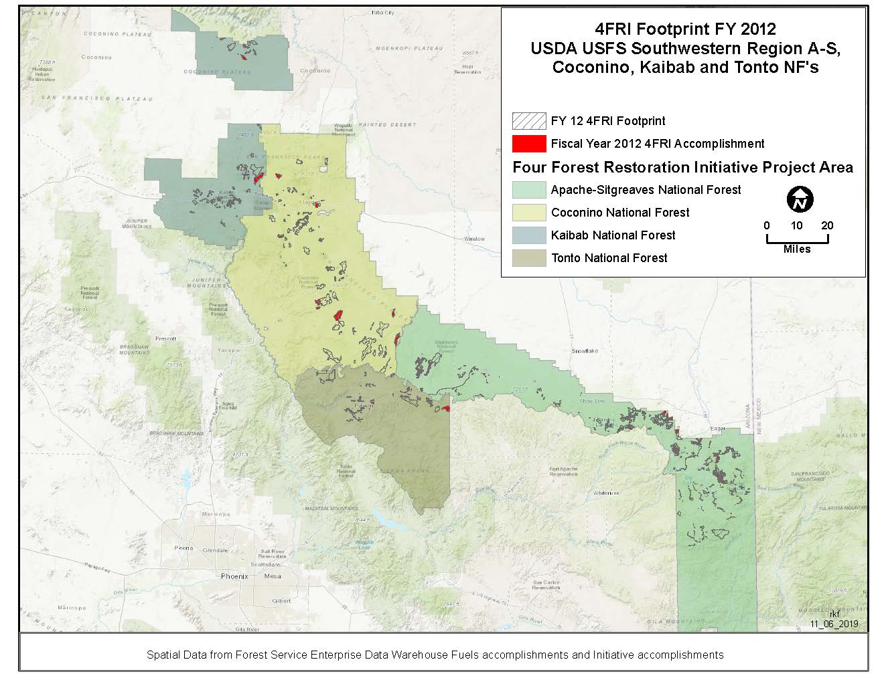

Slide 14
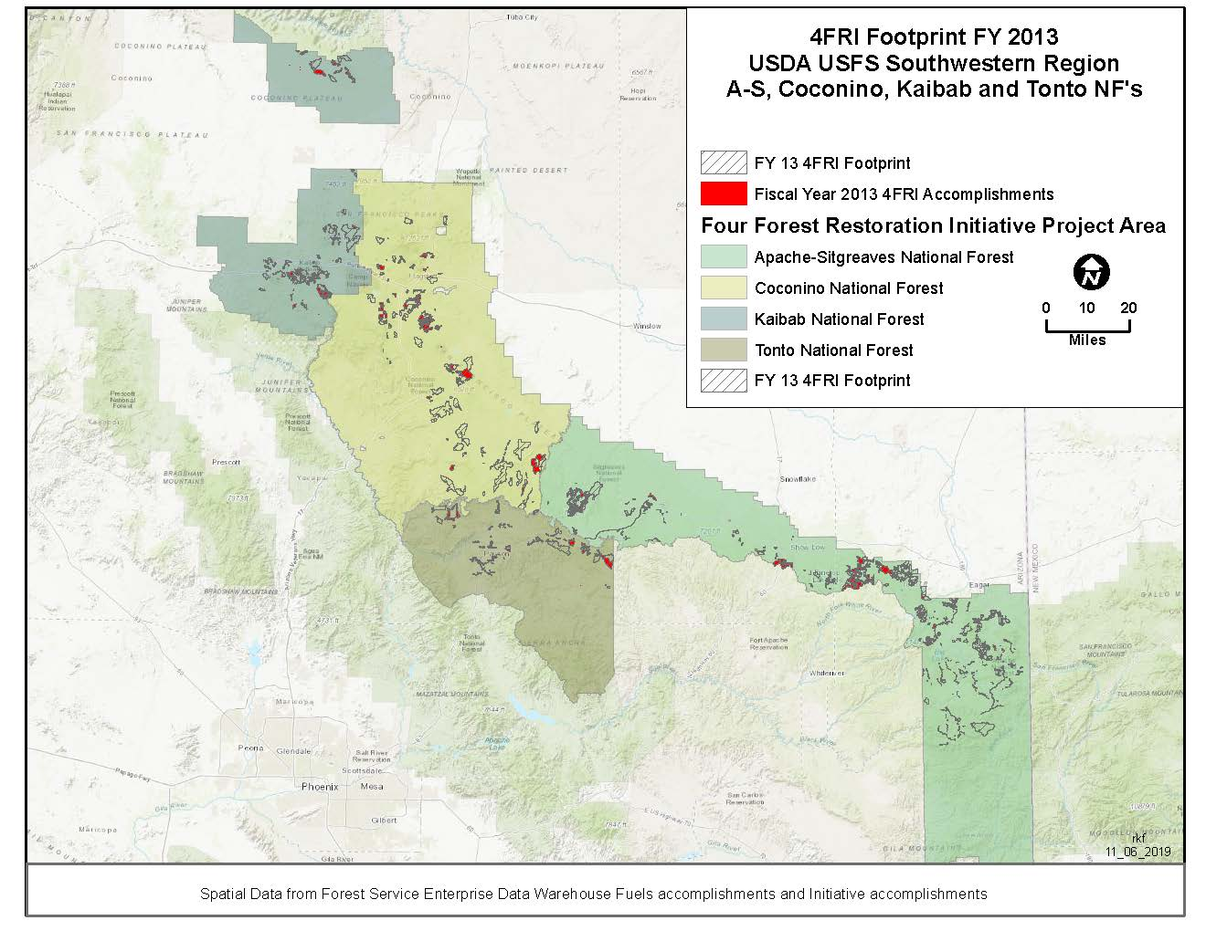

Slide 15
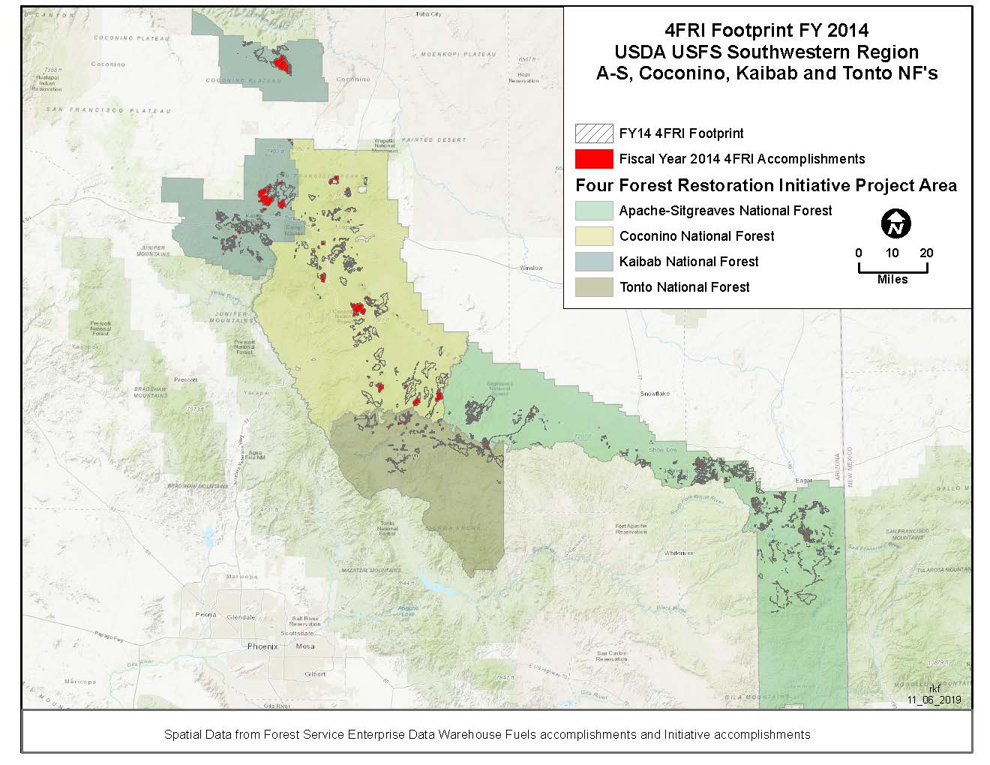

Slide 16
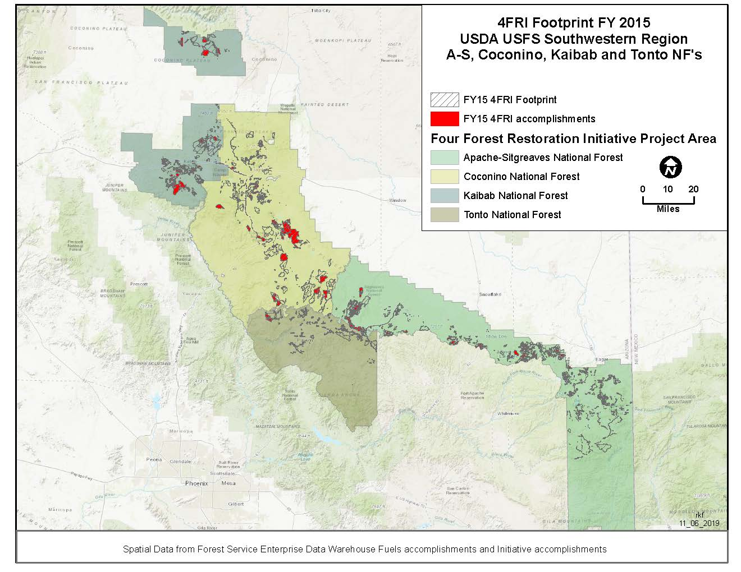

Slide 17
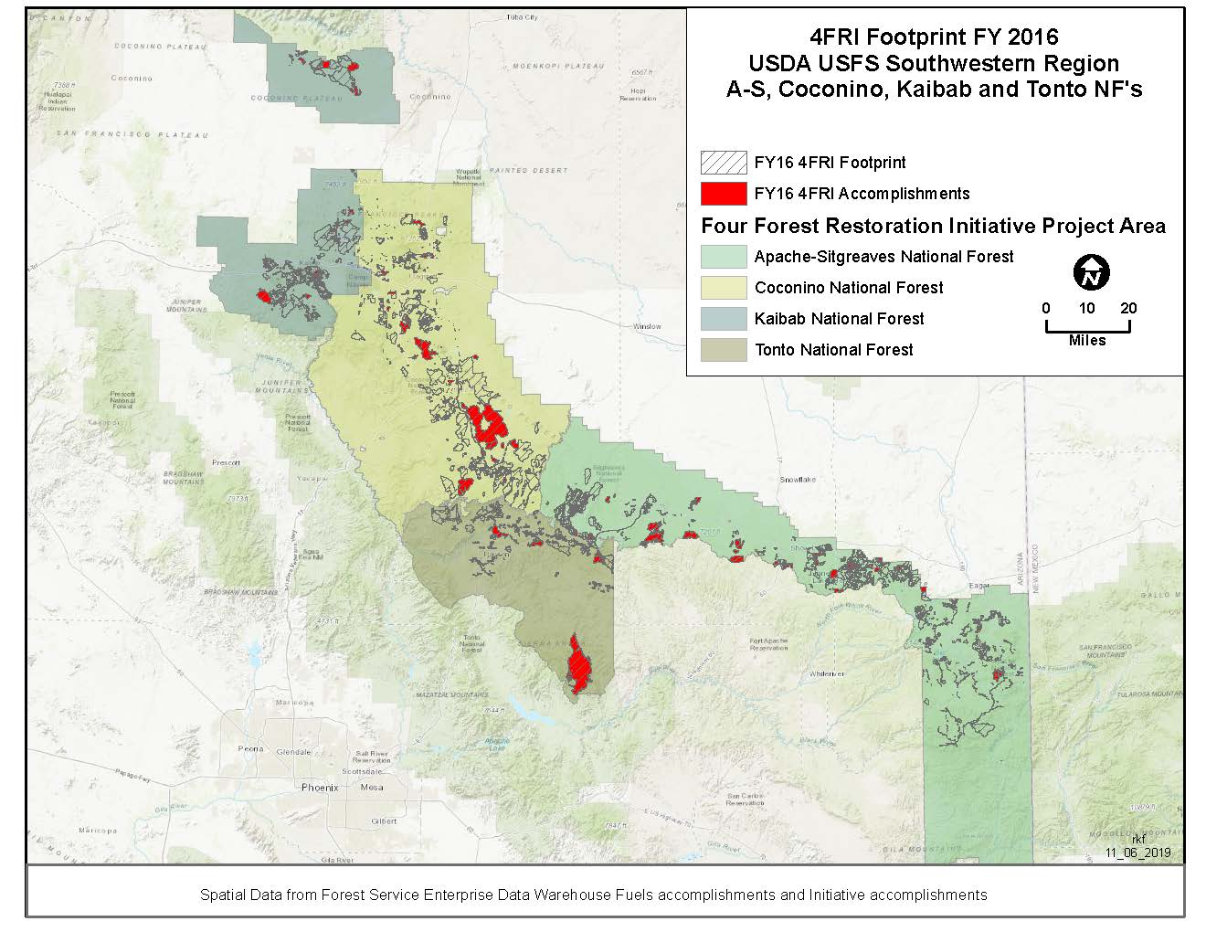

Slide 18
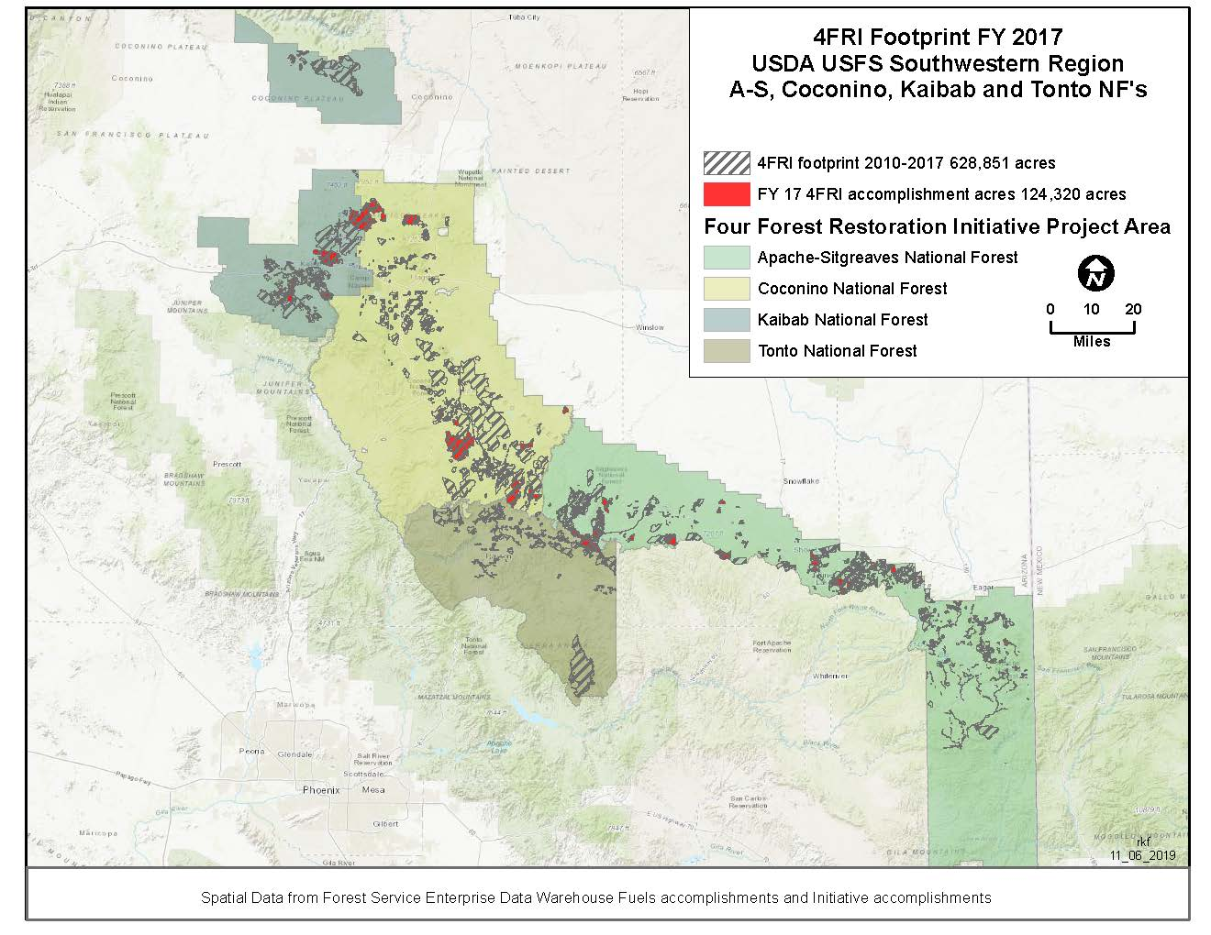

Slide 19
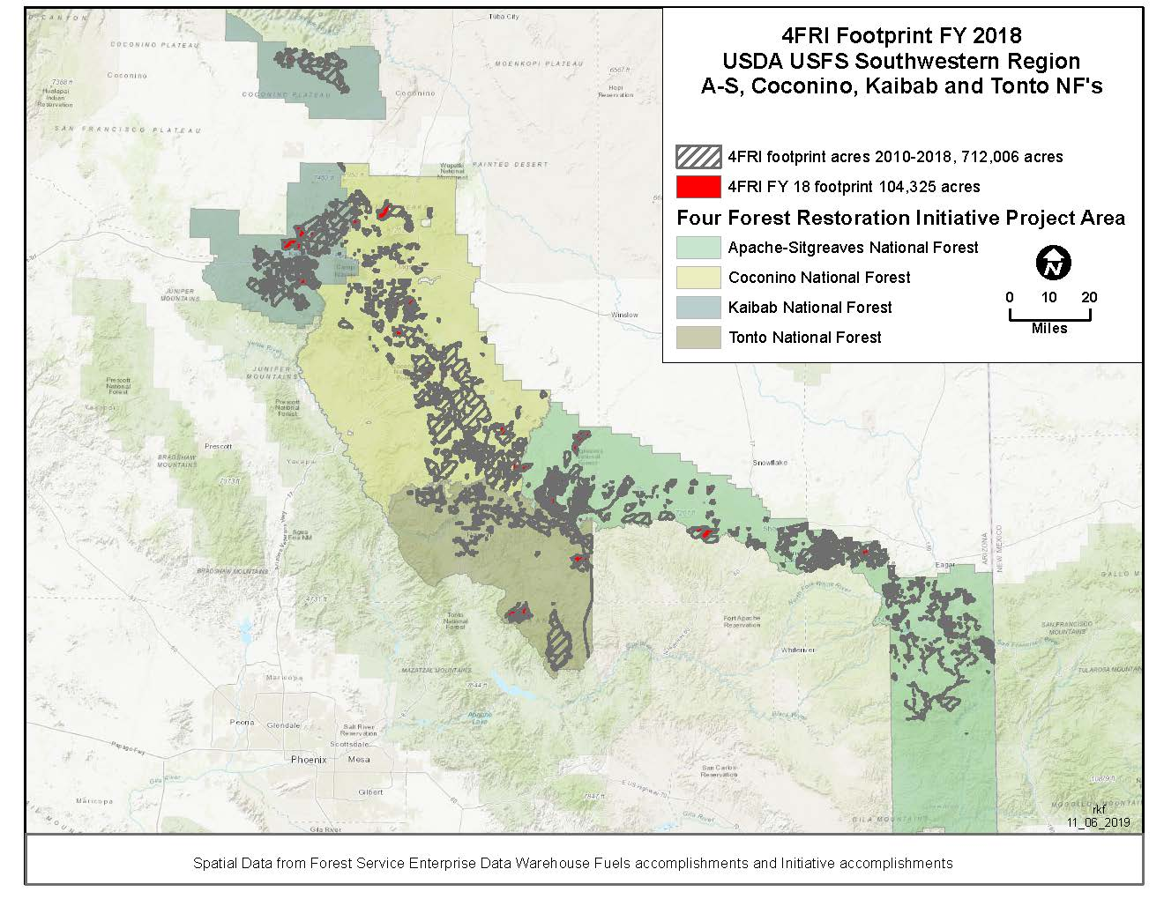

Slide 21
The Bad and the Ugly

Slide 22
The Bad and the Ugly

Slide 23
The Bad and the Ugly

Slide 24
The Bad and the Ugly

Slide 25
The Bad and the Ugly

Slide 26
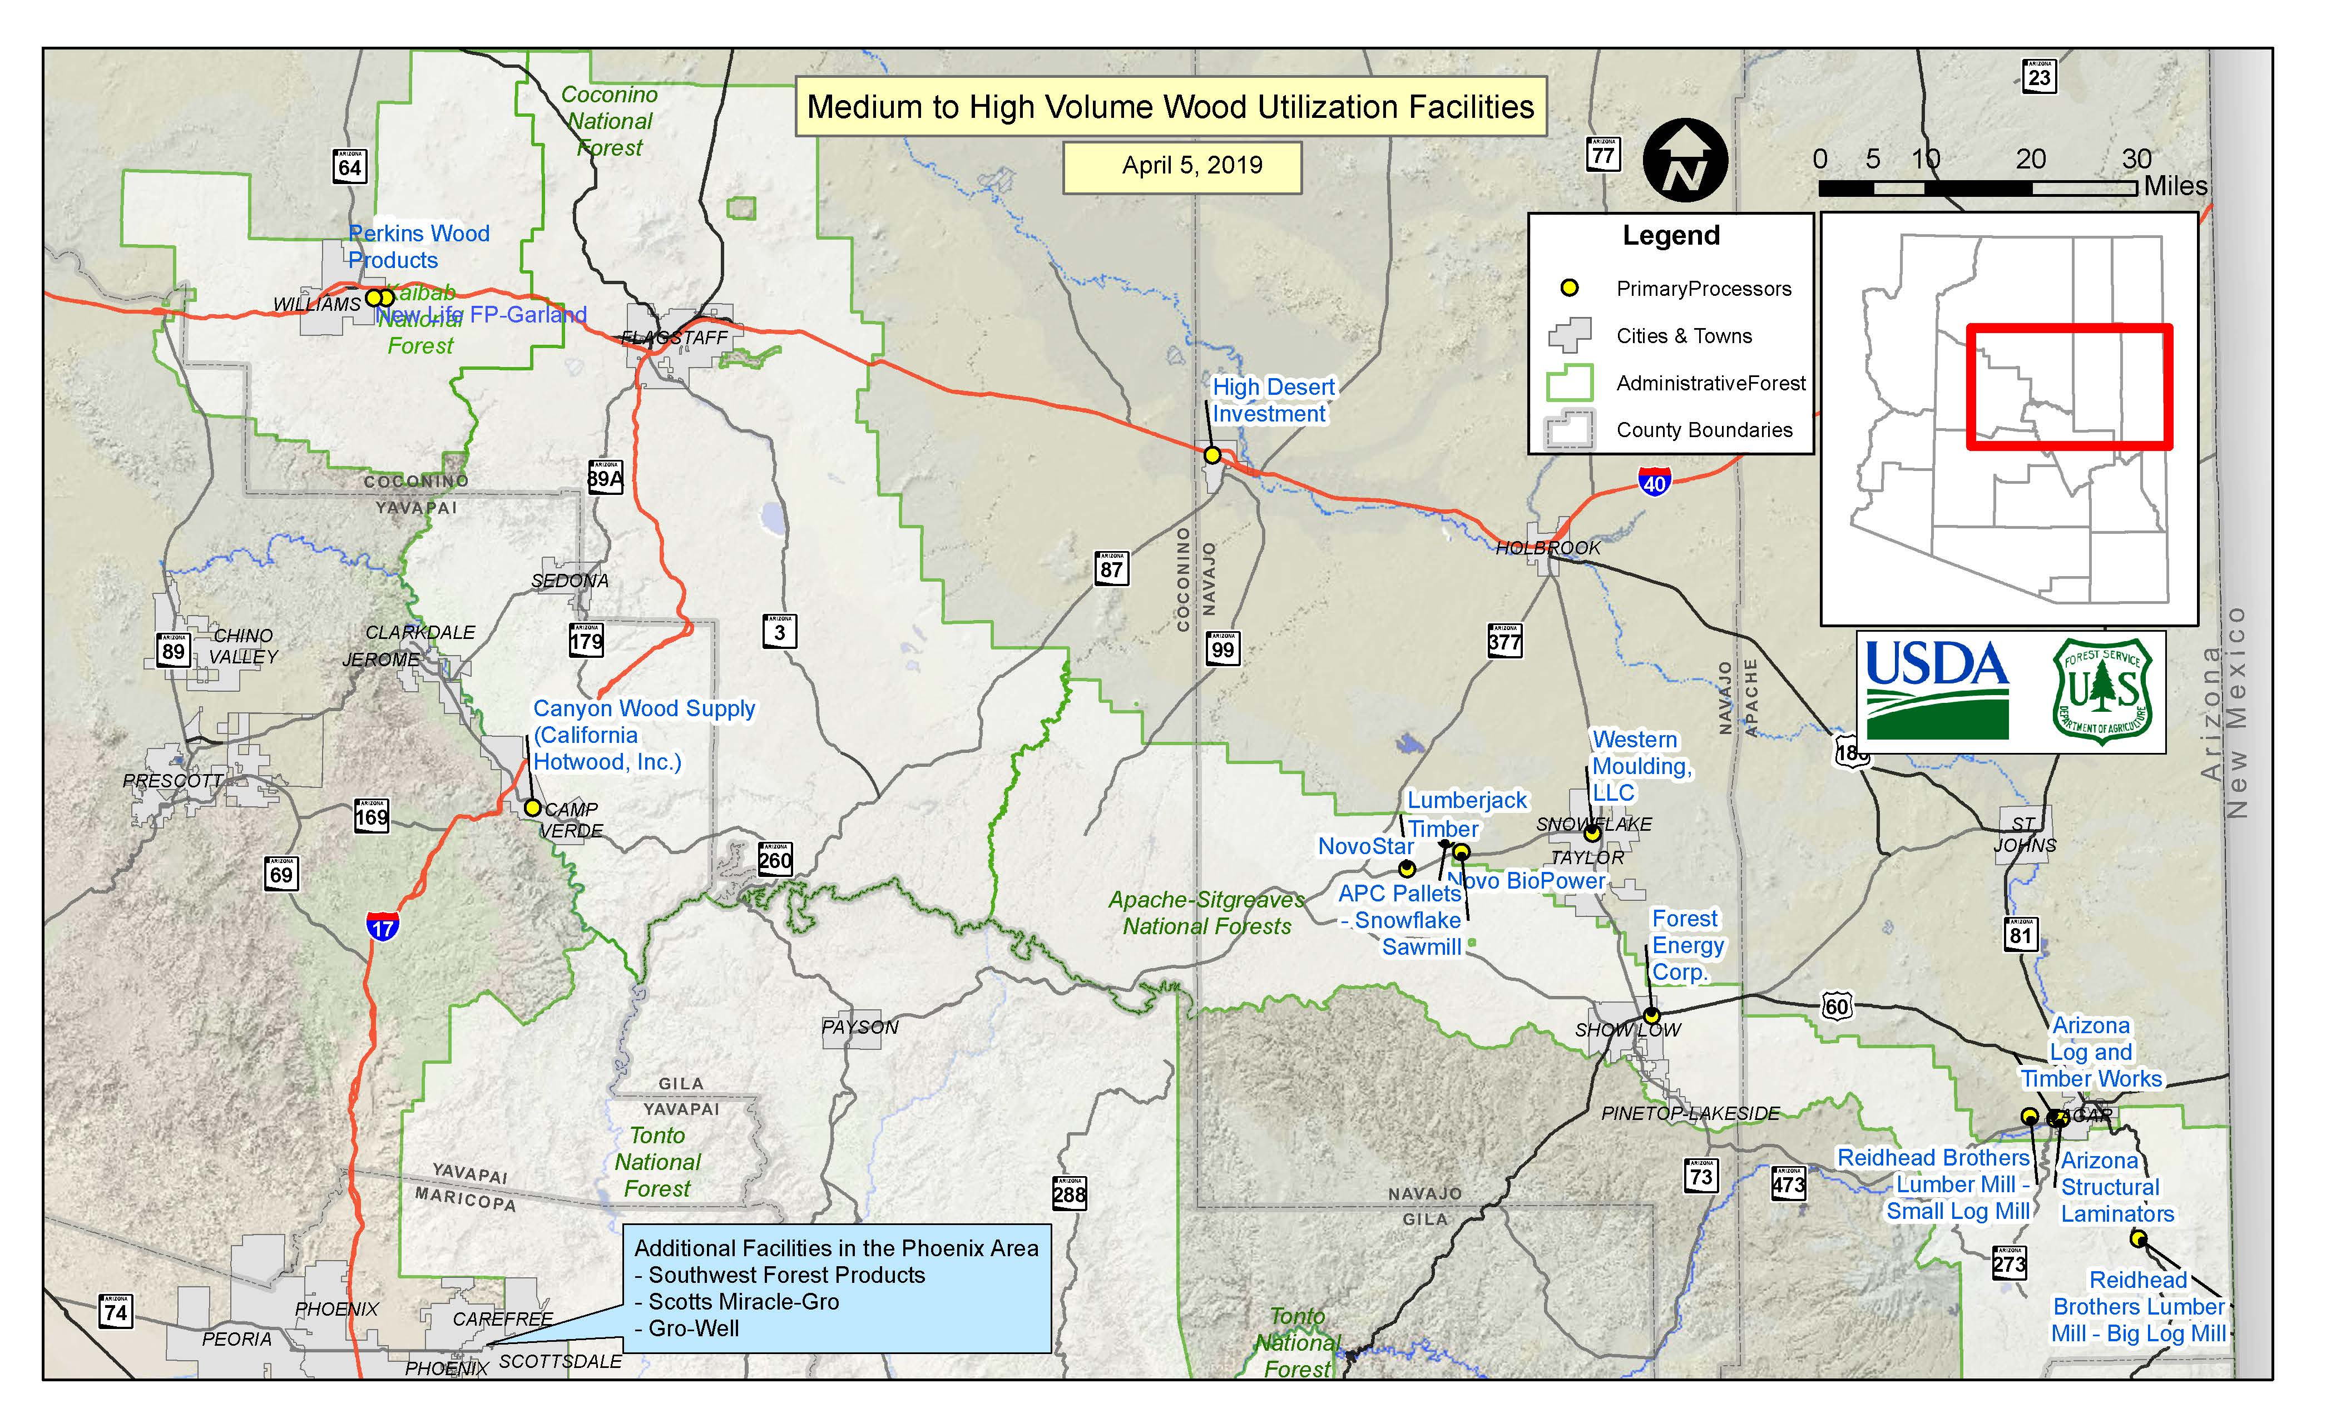

Slide 27
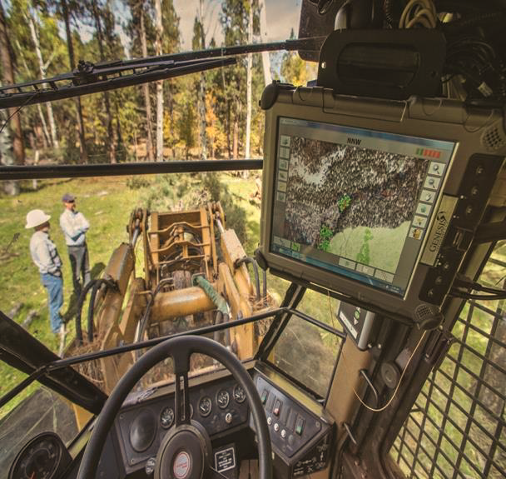
Modernization
Multiple Efforts to improve efficiencies across 4FRI including:
Use of tablets for Designation by Prescription
Virtual Boundaries
Use of LiDAR
Log accountability, branding and barcoding
Extended drying times in woods
Increased weight limits for logging trucks
Larger prescribed burn blocks/aerial ignition

Slide 28
Modernization Outputs

Slide 29
Summary--Restoration from CFLRP Act
Restoration is defined in the act¹ as the following activities:
(A) Reduce the risk of uncharacteristic wildfire, including through the use of fire for ecological restoration and maintenance and reestablishing natural fire regimes, where appropriate-great with fire and increasing, mechanical harvest behind our goal and trend not increasing;
(B) Improve fish and wildlife habitat, including for endangered, threatened, and sensitive species; have improved habitat both terrestrial and stream and pace shows increasing trend;
(C) Maintain or improve water quality and watershed function; Watershed improvement or maintenance accelerated with increasing trend;
(D) Prevent, remediate, or control invasions of exotic species; trend is down for treatments of noxious weeds;
(E) Maintain, decommission, and rehabilitate roads and trails; trend is down for roads and trails;
(F) Use woody biomass and small-diameter trees produced from projects implementing the strategy; trend is down for biomass, acres offered and awarded trend is up, but not cut, no significant increase in industry capacity.
¹PL 111-11 Omnibus Public Land Management Act of 2009 Title IV Sec 4003 (c) (3)

